Slide 1

DriverPass System Analysis
Rikka Eng
Notes:
Hello, Welcome Everyone. My name is Rikka Eng, I’ll be presenting the DriverPass system and its many features. Just like in the interview, we’ve designed this tool to help learners prepare for their DMV driving test. The system provides both online learning resources such as downloadable notes for DMV rules and policies, online video lectures, and scheduling for on the road, in person lessons. All this is aimed at improving the success rates of students taking their driving tests. Let’s move into some system requirements, diagrams, and security aspects to give you a clear understanding of how this system will meet DriverPass’ s needs.

Slide 2

System Requirements
Functional Requirements
The system shall allow students to register and schedule driving lessons online
The system shall provide access to online practice tests and download online lecture materials.
Non-Functional Requirements
The system shall run on popular web browsers like Chrome, Safari, and Edge, and utilize cloud infrastructure to handle increasing users and data. (Scalable & Cross-Compatible)
The system shall ensure security measures through the use of role-based authority and encrypted transfers of data. (Security)
Notes:
[In your speaker notes, include an explanation of the different requirements you determined for DriverPass’s system. What are the functional requirements you selected to describe? What are the nonfunctional requirements you selected to describe? Be sure to explain how these requirements meet DriverPass’s needs.]
DriverPass is a fully online system that is designed with user flexibility and business maintainability in mind. While we’ve gone over many Functional & Non-Functional services for DriverPass in the interview. These are just some of the core ones to adhere to these descriptions.
Student Registration & Lesson Scheduling: The system will allow students to register accounts and schedule driving lessons online. This meets DriverPass’s need for student to independently book their lessons from any device anywhere, whether it’s on a desktop such as Windows or Mac, or a mobile device such as Android or iOS. This is both convenient for both the company and students themselves, as the company doesn’t have to resort to manual drafts and distributions of pen and paper calendars and tickets, and instead have the ease of computer-based automation.
Access to Online Practice Tests and Lessons: The system provides access to online video lessons, lecture notes, and practice tests. This helps DriverPass deliver comprehensive training for students to better prepare for the DMV exams, ensuring that they have the resources they need to get through the test.
Cross-browser Compatibility & Cloud Infrastructure: The system will run on major web browsers like Chrome, Safari, and Edge, ensuring compatibility across different types of systems such as Windows, Linux, maxOS, and mobile devices. Additionally, the system will also make sure of Cloud Infrastructure to allow for the benefits of scalability to handle an increase number of students and data as DriverPass may potentially grow.
Security Features: To ensure data protection, the system will include role-based access control, meaning different users like students, instructors, and admins will have different privileges and permissions. Admins will have a higher authority to block or remove suspicious users and security threats, on top of this, a layer of protection will be added to all data transfers will be encrypted, ensuring the safety and security of sensitive information such as student data and payment details.

Slide 3
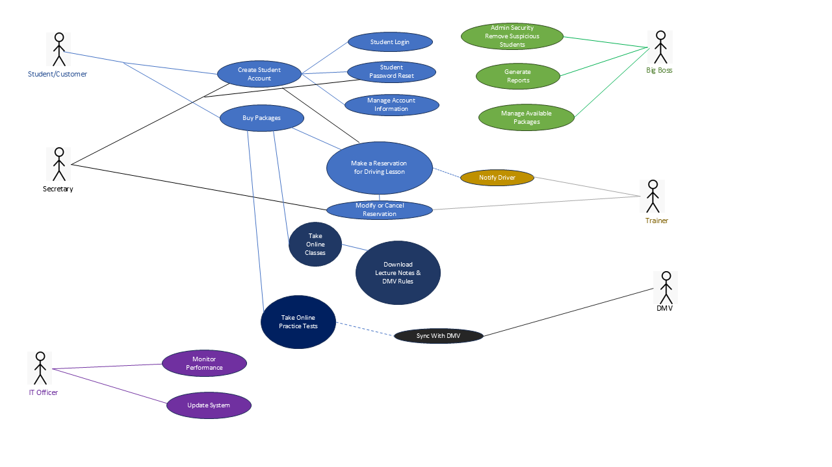
Use Case Diagram
[Insert your use case diagram here.]
Notes:
[Explain your diagram. Who are the different actors in the system? What are the different use cases? How did you account for DriverPass’s needs in your design? In your explanation, keep your audience in mind. Avoid the use of terms like “actors” and “use cases” in your explanation.]
In this diagram, we can see how different people (users) interact with the DriverPass system. Each user has different interactions and relationships within it.
Students: Can create accounts, book lessons, access learning materials, take practice tests to prepare for their driving exams. In order to use all of DriverPass’s features, they’ll have to purchase the appropriate package.
Secretaries: Answer calls and provide help to Customers who may have technical inexperience with creating accounts or making reservations, or even resetting passwords.
Admins: can monitor the system, they can manage or remove suspicious user accounts, generate reports on user activity to find said suspicious accounts, and manage/edit the packages available for users.
Instructors: Are notified when a lesson is booked and can modify appointments if needed.
IT Officer: Have the ability to monitor performance, addressing potential issues such as long loading times and errors. He’ll have access to the front-end development of DriverPass, likely working on JavaScript to update the web-based system to fix any of the potentially mentioned issues. He will also have access to records for customer logins, having exposure to potential suspicious activity such as unrecognized IP addresses entering accounts, or suspicious number of failed attempts on an account.
DMV: the DMV provides up-to-date rules and regulations that are to be downloaded to the online lecture notes, and practice tests.
This diagram was designed to represent the core features that DriverPass has to offer to our customers. Within the middle of the diagram are the important key use-cases, that of making scheduled driving reservations for in person trainers, taking online courses, downloading lecture notes, and taking practice tests are all the core features that were mentioned in the interview for DriverPass.
Make Reservation for Driving Lesson: Currently there are three different levels of packages that a Customer can purchase. These packages are subject to change depending on what the admin wants to be available. Each reservation for a driving lesson will last about 2 hours. Package One will give a customer six hours meaning three lessons, package two: four lessons, and package three: six. Every time a reservation is issued, the Customer can pick the time, location, date, and instructor depending on their availability. Once the reservation is confirmed, the instructor gets a notification, and while the reservation is subject to change. The customer receives their in-person driving lesson.
Online Lectures & Downloading Notes: This is only available for Package three. Students can attend an online course that provides prerecorded lectures for online use. The students can download notes which contains materials such as DMV rules and policies. These are contained in PDF files, so the student only needs to be online once they’ve downloaded the file. After downloading it, they can view the notes whenever they want.
Take Online Practice Tests: Customers with Package Level three are also able to download a separate executable that they can launch any time to start a practice test simulation. These practice tests are updated from the DMV on a weekly basis through an automatic API, as the DMV’s rules and driving practice focal points are ever changing. The practice tests are subject to expire after each following week, and an updating test needs to be downloaded upon so. Students can takes these practices tests and view their scores afterwards, then be given constructive feedback to help them better learn the material.

Slide 4
Security
Role-based access for students, admins, and instructors.
Admins can monitor suspicious activities and lock accounts.
Encrypted connections (SSL/TLS)
Database encryptions (AES-256)
Two-Factor Authentication & Email verifications
IT updates & patches for system errors and poor user feedback.
Notes:
[How did you consider security in your design? In your explanation, keep your audience in mind by avoiding the use of technical terms.]
Role-Based Access & Monitoring Account control: Each user type (students, admins, and instructors) has specific privileges. This means that students have access to the core functions of DriverPass such as taking practice tests and attending online lectures, but admins have broader access to manage the system and its integrity. Such as locking accounts if suspicious activity is detected, and generating reports of user activity and transactions to find such suspicious activity.
Encrypted Connections: All interactions within the system, whether it’s logging in, scheduling lessons, or handling payments, are encrypted using SSL/TLS. This ensures that sensitive information like personal details and payment info, is securely transmitted without being intercepted from hackers.
Database Encryption: Once the information reaches the system, it is stored in an encrypted database using strong encryption algorithms like AES-256. This means that even if the database were to be compromised, the data would be unreadable without the decryption key. Only authorized admins or assigned security will have access to this key and thus the encrypted data. These two layered approaches of encryption methods ensures that sensitive data is protected both during transmissions and while it is stored.
Two-Factor Authentication & Email Verification: To further protect accounts, we’ve implemented a two-factor authentication requirement for log ins. This means that users may need to confirm their identity through a second layer of verification. This extends to the common email verifications or security questions. These are measure to protect against password theft, brute force attacks, or device theft by forcing a user to have a second measure to prove their identity. If you don’t know what Two-Factor Authenticators are, they’re usually provided through an app on your phone. They work similarly to an email verification link, but have different confirmation methods such as simply pressing a confirm button, or entering a short four-to-seven-digit code.
Regular IT Updates and Patches: The system may eventually grow, or bugs might fall through the cracks during development. The system will be continuously monitored for performance and security vulnerabilities are bound to be discovered. The IT Officer will apply regular updates and patches to fix any errors using tools like New Relic or Datadog to locate them during deployment, or he can address areas containing poor user feedback

Slide 5
System Limitations
Economic Viability.
Scalable & Performance
Advanced Security Features
User Satisfaction & Accessibility
Future-proofing
Modularity and Scalable Design
Notes:
[What are the limitations of your design? In your explanation, keep your audience in mind by avoiding the use of technical terms.]
One of the core limitations that came to mind for the design of DriverPass is whether the system is economically viable or not.
Scalability and Performance: If there is a limited budget, the system may not initially support high traffic volumes in the event that high user demand ends up flooding into DrivePass. This will cause huge performance slowdowns of the system. Scaling cloud infrastructure to handle increased user traffic requires more resources (like additional servers), which can increase costs. A budget limit or a spread sheet for market demand may slow down DriverPass’ ability to grow, but growing too fast would risk causing the company to go bankrupt.
Advanced Security Features: While encryption and two-factor authentication are important methods, relying on continuous monitoring by important figures such as the Admin and IT Officer could serve troublesome. These leaders may have to juggle between other system monitor and other responsibilities. For example, the IT Officer may be occupied with extensive patching work or updates for DriverPass. Or the Admin may have a legal problem with the company and is expected to provide company records that DriverPass’s report system does not offer, and they’ll have to spend a long time creating this data from scratch. Entrusting an important task such as system monitoring to these officials might serve troublesome. Hiring a second experienced employee with the main job of this might be beneficial for DriverPass. Whether or not we should also purchase advanced detection system or have tighter deadlines for more frequent patches. Between making decisions of hiring a stronger IT/Development team and tools to accommodate them, this is highly dependent on what DriverPass can currently afford.
User Satisfaction & Accessibility: We mentioned a secretary to help non-technical users with the process of purchasing packages, creating an account, and scheduling a driving lesson through the phone. However, this means that heavier resources are put into the hiring onboard process of DriverPass as we will have to thoroughly search for technologically fluent staff in both driving instructors and secretaries. The Driving Instructor part is critical, and we may have to hire additional secretaries or even a dedicated support team which will increase operational costs to ensure that driving instructors are also comfortable using the system.
Future-proofing: Budget constraints could force the team to prioritize immediate needs over long-term growth. For example, DriverPass may need to focus on building only core features that are crucial to launch, such as basic scheduling, lesson management, and account creation, rather than investing in other features such as mobile integration. There’s also the consideration of technical debt, as a less optimial solution for immediate functionality at the cost of future flexibility or performance. DriverPass may have to rely on cost-effective but potentially limited solutions like skipping auto-scaling in the cloud or postponing robust backup system, this might make the system less flexible and more prone to performance issues during periods of growth but will make it through the budget constraints.
Modularity and Scalable Design: In the event that DriverPass enters early development, it is paramount that the system adhere to a modular architecture in its framework and design. The aim of the system is to provide future updates and scale with the size of its audience, so it’s important that development with modularity in mind is kept as a high priority even if budget constraints causes other tasks to be put on the side.

